Slide 1
Lecture -12
Engineering Mechanics
Analysis of Structures

Slide 2
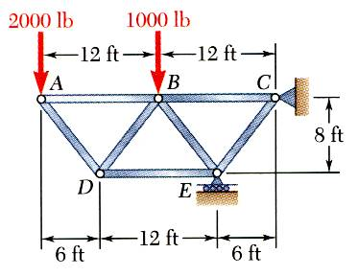
Solution to Problem 1
Using the method of joints, determine the force in each member of the truss.

Slide 3
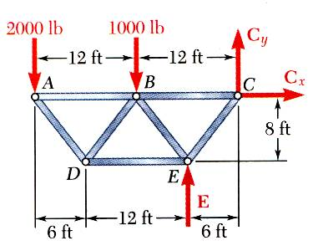
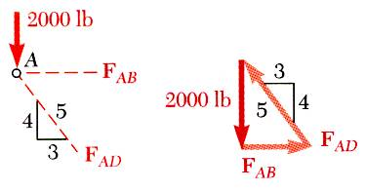
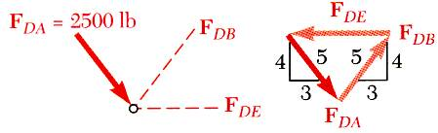
Solution to Problem 1

Slide 4
Solution to Problem 1

Slide 5
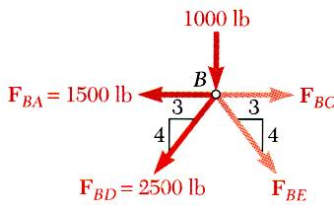
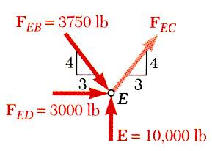
Solution to Problem 1

Slide 6
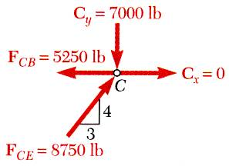
Solution to Problem 1

Slide 7
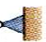
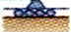
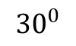
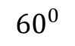
Analysis of Trusses: Method of joints
P
a
a
a
A
B
$${30}^{0}$$
$${60}^{0}$$
C

Slide 8
Analysis of Trusses: Method of joints
P
a
a
a
A
B
$${30}^{0}$$
$${60}^{0}$$
C

Slide 9
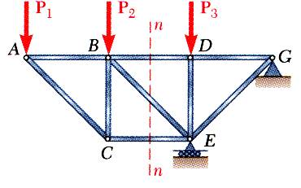
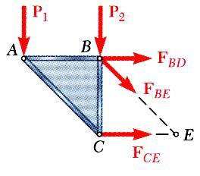
Analysis of Trusses: Method of section
When the force in only one member or the forces in a very few members are desired, the method of sections works well.
To determine the force in member BD, form a section by “cutting” the truss at n-n and create a free body diagram for the left side.
An FBD could have been created for the right side, but why is this a less desirable choice? Think and discuss.
Notice that the exposed internal forces are all assumed to be in tension.
With only three members cut by the section, the equations for static equilibrium may be applied to determine the unknown member forces, including F_{BD}.

Slide 10
Analysis of Trusses: Method of section
Using the left-side FBD, write one equilibrium equation that can be solved to find F_{BD}. Check your equation with a neighbor; resolve any differences between your answers if you can.
Assume that the initial section cut was made using line k-k. Why would this be a poor choice? Think, then discuss with a neighbor.
p
k
p
Notice that any cut may be chosen, so long as the cut creates a separated section.
So, for example, this cut with line p-p is acceptable.
k

Slide 11
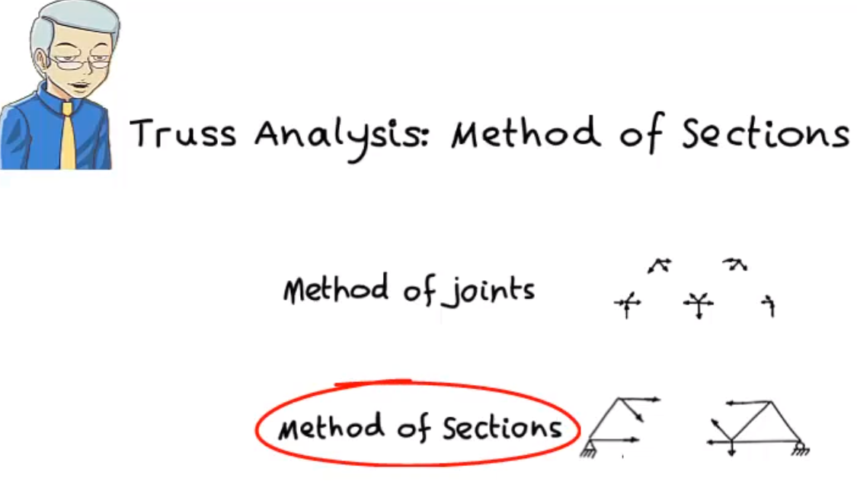
Analysis of Trusses: Method of joints/ section
See this video
https://www.youtube.com/watch?v=Svv721BSte0

Slide 12
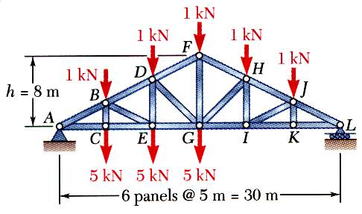
Analysis of Trusses: Method of joints/ section
Determine the force in members FH, GH, and GI.
SOLUTION:
List the steps for solving this problem. Discuss your list with a neighbor.
Draw the FBD for the entire truss. Apply the equilibrium conditions and solve for the reactions at A and L.
Make a cut through members FH, GH, and GI and take the right-hand section as a free body (the left side would also be good).
Apply the conditions for static equilibrium to determine the desired member forces.

Slide 13
Analysis of Trusses: Method of joints/ section
SOLUTION:
Take the entire truss as a free body. Apply the conditions for static equilibrium to solve for the reactions at A and L.

Slide 14
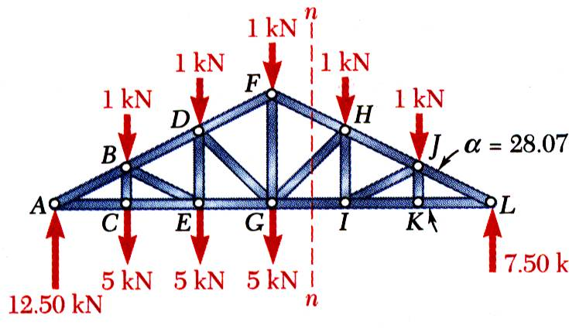
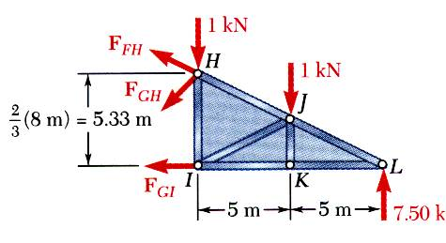
Analysis of Trusses: Method of joints/ section
Make a cut through members FH, GH, and GI and take the right-hand section as a free body. Draw this FBD.
What is the one equilibrium equation that could be solved to find F_{GI}? Confirm your answer with a neighbor.
Sum of the moments about point H:

Slide 15
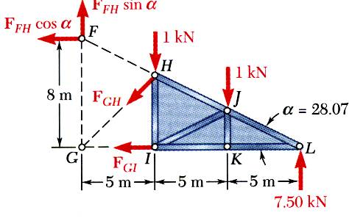
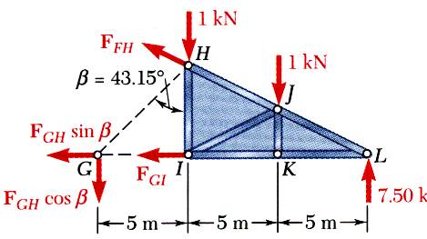
Analysis of Trusses: Method of joints/ section
F_{FH} is shown as its components. What one equilibrium equation will determine F_{FH}?
There are many options for finding F_{GH} at this point (e.g., SF_{x}=0, SF_{y}=0). Here is one more:

Slide 16
Acknowledgement
NPTEL lectures on Engineering Mechanics
Beer & Johnston, Vector Mechanics for Engineers
Meriam & Kraige, Engineering Mechanics
Problems taken from internet sources
Timoshenko & Young, Engineering Mechanics

